Slide 1
CS 316: Introduction to Deep Learning
Linear Algebra Overview
Week 2
Dr Abdul Samad

Slide 2
Lecture Outline
Motivation
Notation
Scalars
Vectors
Matrices
Vector and matrix calculations

Slide 3
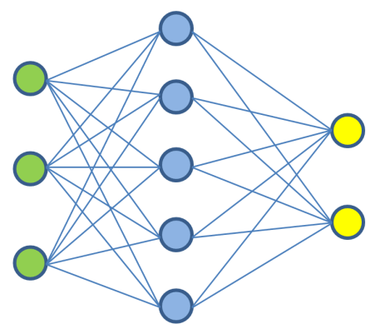

Neural Networks – Matrix Operations
Yes, it’s a cat
Matrix
Matrix
Matrix
Matrix
Slide adapted from DeepLearning.ai

Slide 4
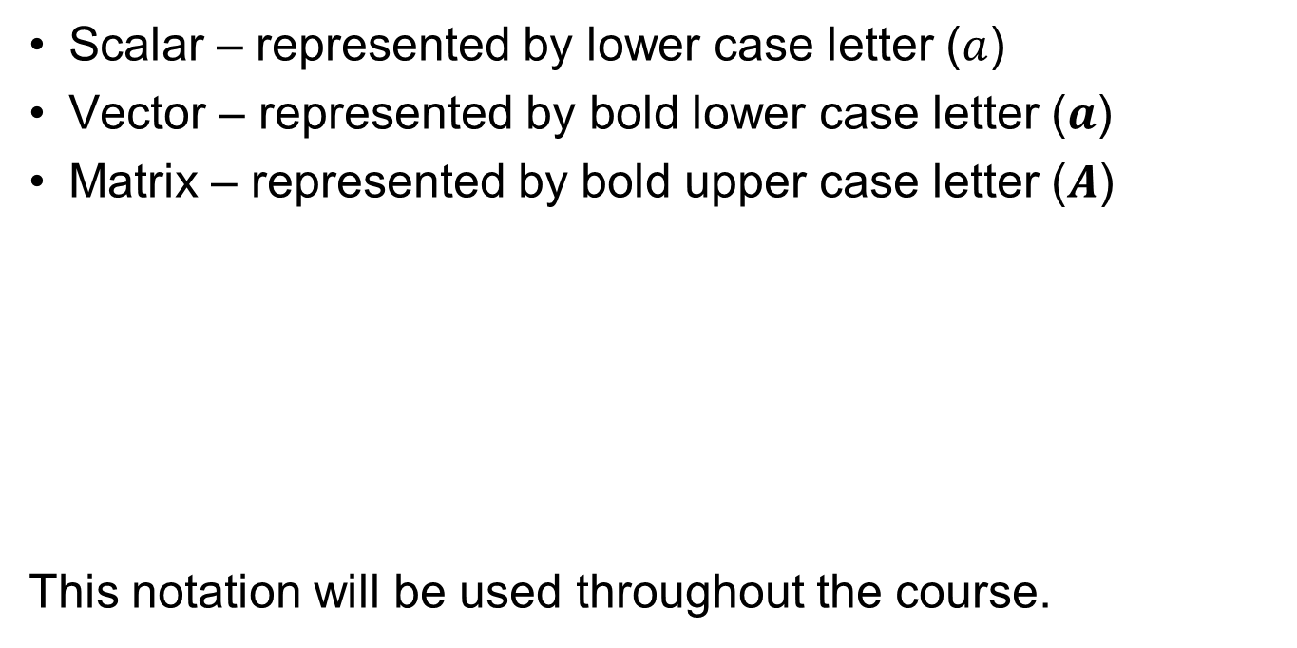
Notation
Scalar – represented by lower case letter ($a$)
Vector – represented by bold lower case letter ($a$)
Matrix – represented by bold upper case letter ($A$)
This notation will be used throughout the course.

Slide 5
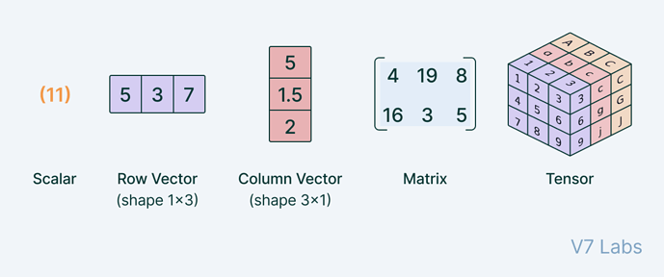
Scalars vs Vectors vs Matrices vs Tensors
Figure taken from Kaggle

Slide 6
Scalar
Variable described by a single number
0th order tensor
Simple Operations
Addition
Multiplication
Function
Length

Slide 7

Scalar Operations
Addition
$$c=a+b$$
Multiplication
$$c=a. b$$
Function
$$c=sin⁡(a)$$

Slide 8

Length
$\left|a\right|= \left\{\begin{aligned}a if a >0 \\ −a otherwise\end{aligned}\right.$
$\left|a+b\right|≤ \left|a\right|+|b|$
$\left|a⋅b \right|=\left|a\right|⋅\left|b\right|$

Slide 9
Vector
Variable described by a list of scalars
1st order tensor
Simple Operations
Addition
Multiplication
Function
Length

Slide 10
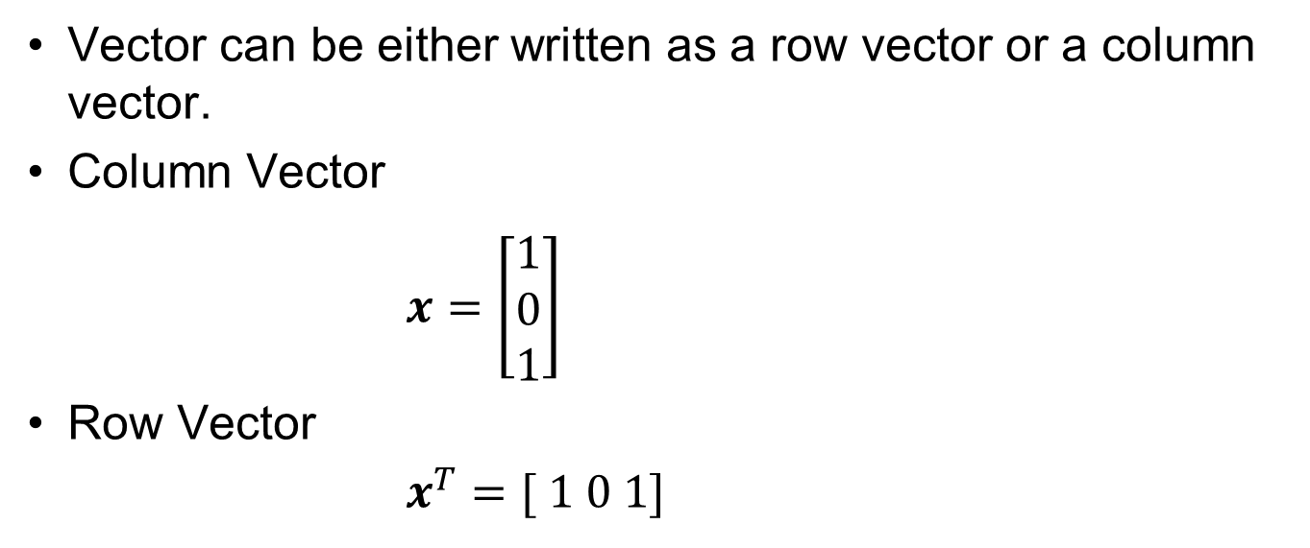
Vector Orientation
Vector can be either written as a row vector or a column vector.
Column Vector
$x=\left[\begin{matrix}1 \\ 0 \\ 1\end{matrix}\right]$
Row Vector
$x^{T}=[ 1 0 1]$

Slide 11
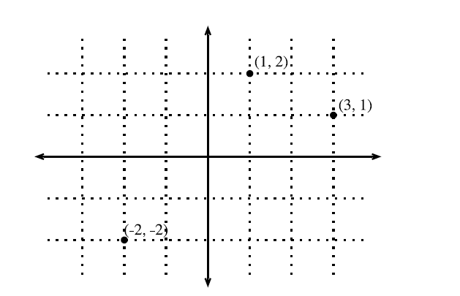
Geometric view – Point in Space
Figure taken from d2l.ai
Notes:
The first component gives the x-coordinate
The second component gives the y-coordinate
Higher dimensions are analogous, although much harder to visualize.

Slide 12
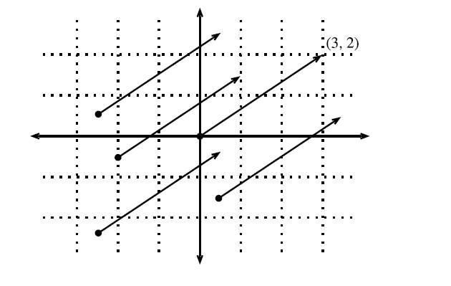
Geometric view – Direction in Space
Figure taken from d2l.ai
Notes:
We think of the vector v = [3,2]T as the location 3 units to the right and 2 units up from the origin, we can also think of it as the direction itself to take 3 steps to the right and 2 steps up.

Slide 13
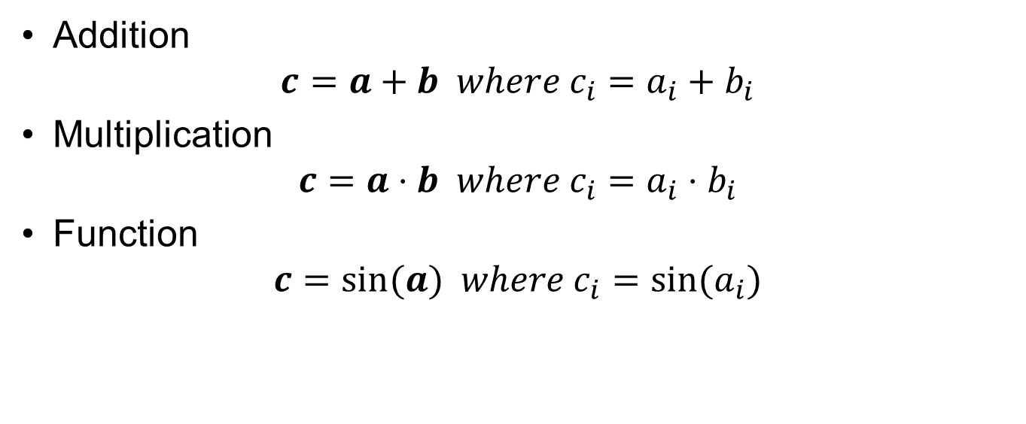
Vector Operations
Addition
$$c=a+b where c_{i}=a_{i}+b_{i}$$
Multiplication
$$c=a⋅b where c_{i}=a_{i}⋅b_{i}$$
Function
$$c=sin⁡(a) where c_{i}=sin⁡(a_{i})$$

Slide 14
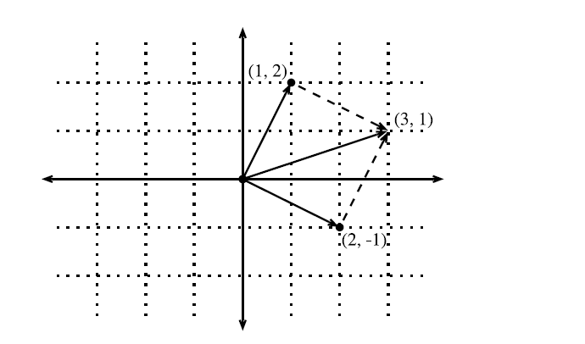
Geometric view - Vector Addition
Figure taken from d2l.ai
Notes:
We can visualize vector addition by first following one vector, and then another.

Slide 15
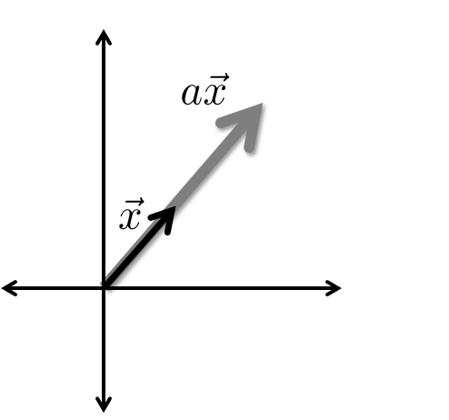
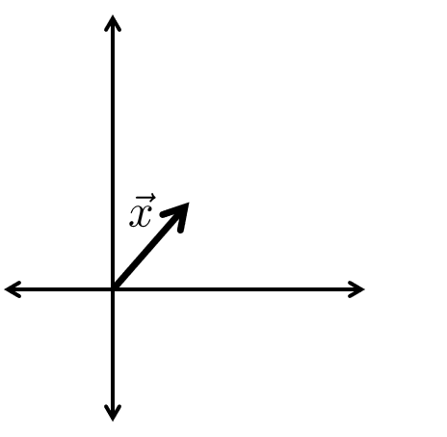
Geometric view – Scaling a Vector
Notes:
We can visualize vector addition by first following one vector, and then another.

Slide 16
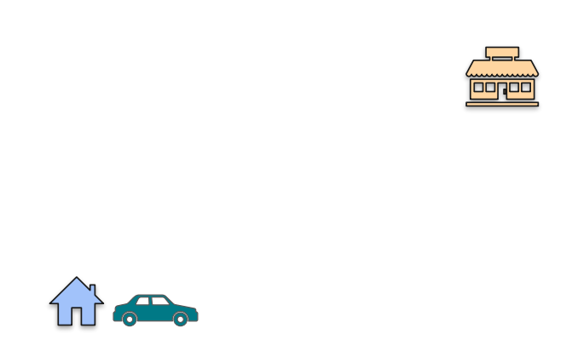
How to get from point A to point B ?
Slide adapted from DeepLearning.ai

Slide 17
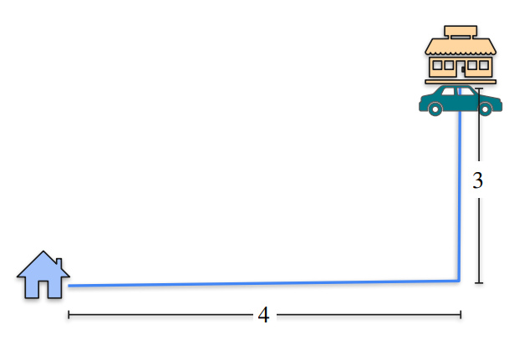

How to get from point A to point B ?
$$Distance=3+4=7$$
Slide adapted from DeepLearning.ai

Slide 18
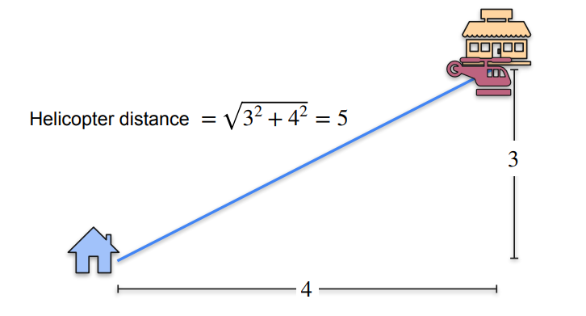
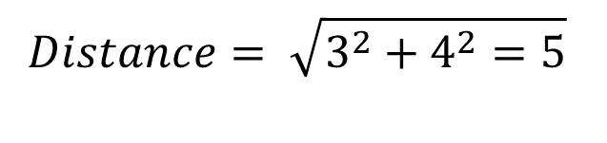
How to get from point A to point B ?
$$Distance= \sqrt{3^{2}+4^{2}=5}$$
Slide adapted from DeepLearning.ai

Slide 19
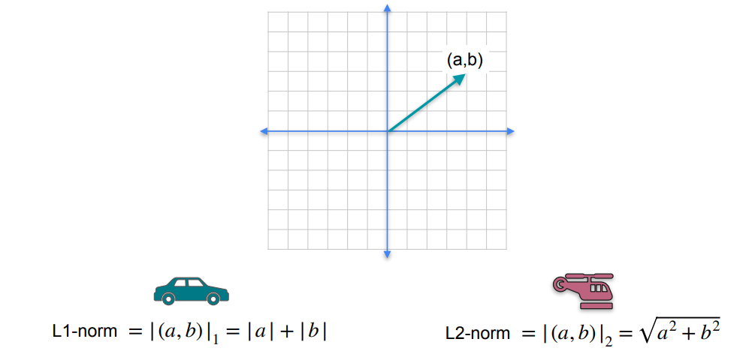
Norms
Slide adapted from DeepLearning.ai

Slide 20
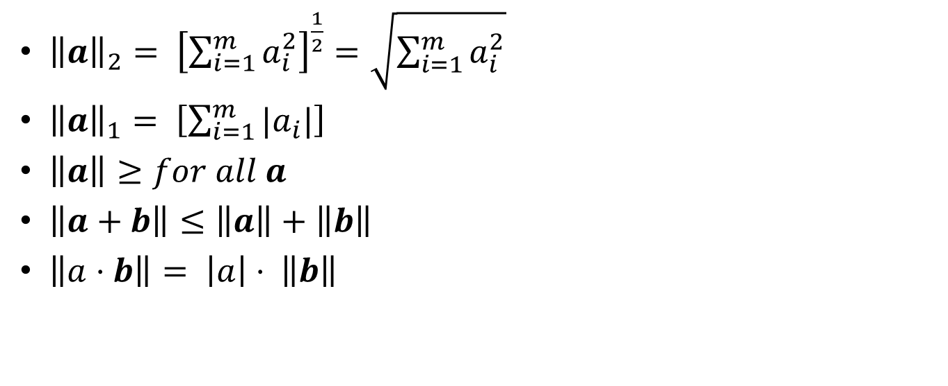
Vector Norm
${\left\|a\right\|}_{2}= {\left[\sum_{i=1}^{m}{a_{i}^{2}}\right]}^{\frac{1}{2}}=\sqrt{\sum_{i=1}^{m}{a_{i}^{2}}}$
${\left\|a\right\|}_{1}= \left[\sum_{i=1}^{m}{|a_{i}|}\right]$
$\left\|a\right\|≥for all a$
$\left\|a+b\right\|≤\left\|a\right\|+\left\|b\right\|$
$\left\|a⋅b\right\|= \left|a\right|⋅ \left\|b\right\|$

Slide 21
Vector – Vector Multiplication
Element-wise multiplication
Inner product (Dot Product)
Outer product

Slide 22

Element-wise multiplication
$a⊙b= \left({a_{1} \atop \begin{aligned}a_{2} \\ ⋅ \\ ⋅ \\ a_{n}\end{aligned}}\right) ⊙ \left({b_{1} \atop \begin{aligned}b_{2} \\ ⋅ \\ ⋅ \\ b_{n}\end{aligned}}\right)= \left({a_{1}b_{1} \atop \begin{aligned}a_{2}b_{2} \\ ⋅ \\ ⋅ \\ a_{n}b_{n}\end{aligned}}\right)$

Slide 23
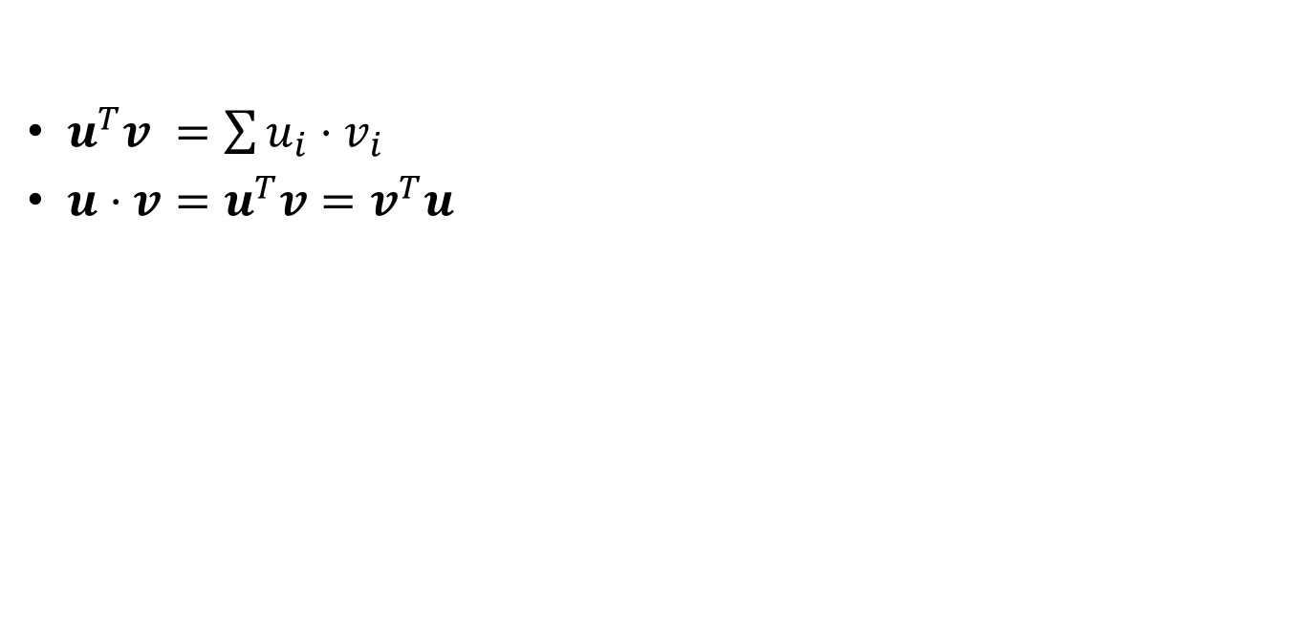
Inner Product
$u^{T}v =\sum{u_{i}⋅v_{i}}$
$u⋅v=u^{T}v=v^{T}u$

Slide 24
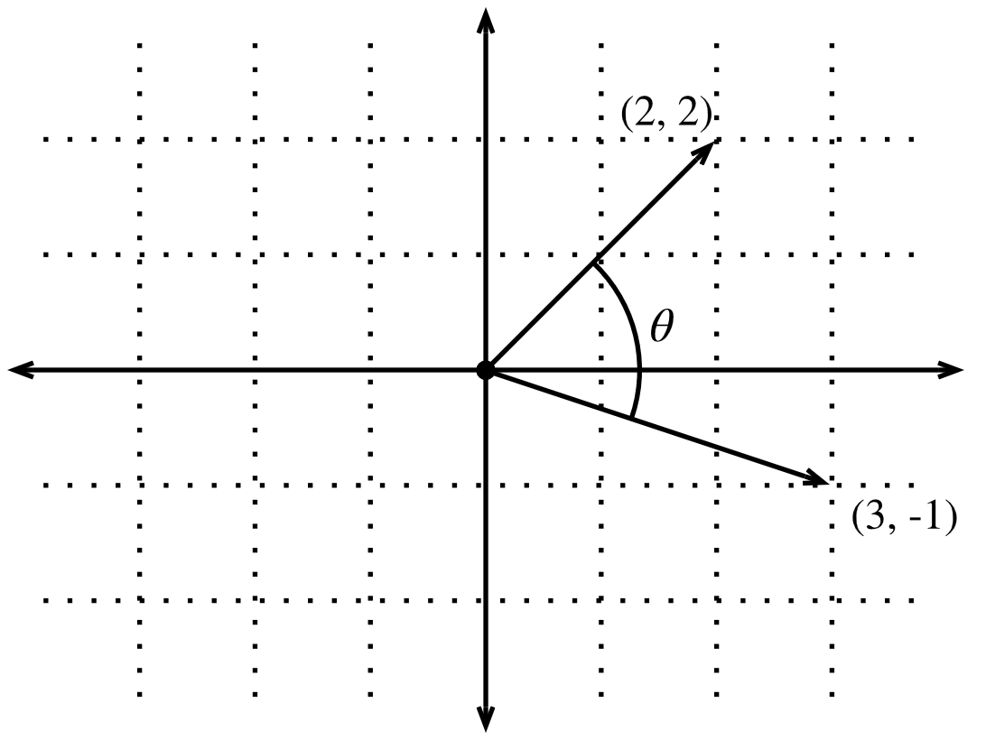

Geometric View – Inner Product
$u⋅v= \left\|u\right\| \left\|v\right\|\cos\left(θ\right)$
$θ=arcos (\frac{u⋅v }{\left\|u\right\|\left\|v\right\|} )$
Figure taken from d2l.ai

Slide 25
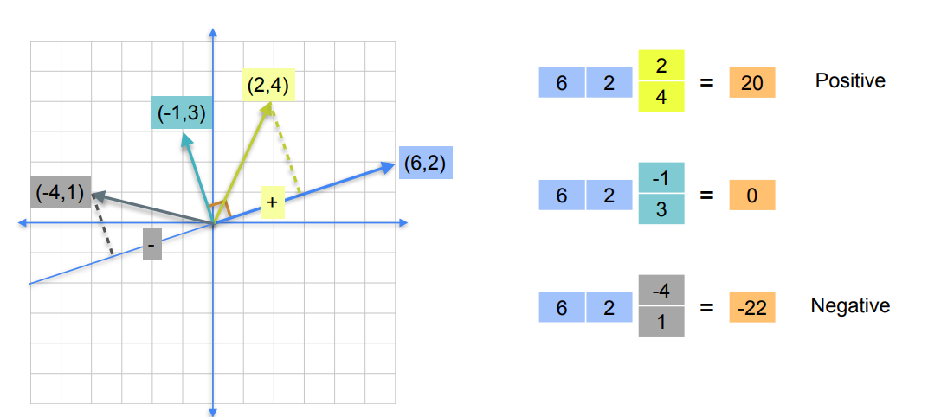
Visualizing Dot Product
Slide adapted from DeepLearning.ai

Slide 26
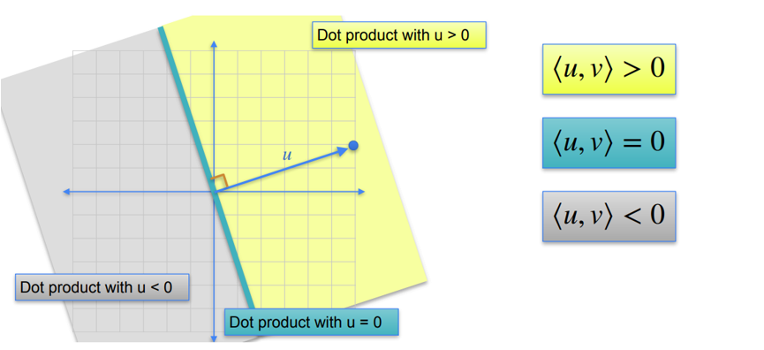
Visualizing Dot Product
Slide adapted from DeepLearning.ai

Slide 27

Outer Product
$xy^{T}= \left[\begin{aligned}x_{1} \\ x_{2} \\ ⋅ \\ ̇ \\ x_{n}\end{aligned}\right]⋅\left[ y_{1} y_{2}⋅ ⋅ ⋅y_{m}\right]= \left[\begin{matrix}x_{1}y_{1} & x_{1}y_{2} & … & x_{1}y_{m} \\ x_{2}y_{1} & x_{2}y_{2} & … & x_{2}y_{m} \\ ⋮ & ⋮ & ⋱ & ⋮ \\ x_{n}y_{1} & x_{n}y_{2} & … & x_{n}y_{m}\end{matrix}\right]$

Slide 28
Matrix
Variable described by a list of vectors.
2nd order tensor
Simple Operations
Addition
Multiplication
Function
Length

Slide 29
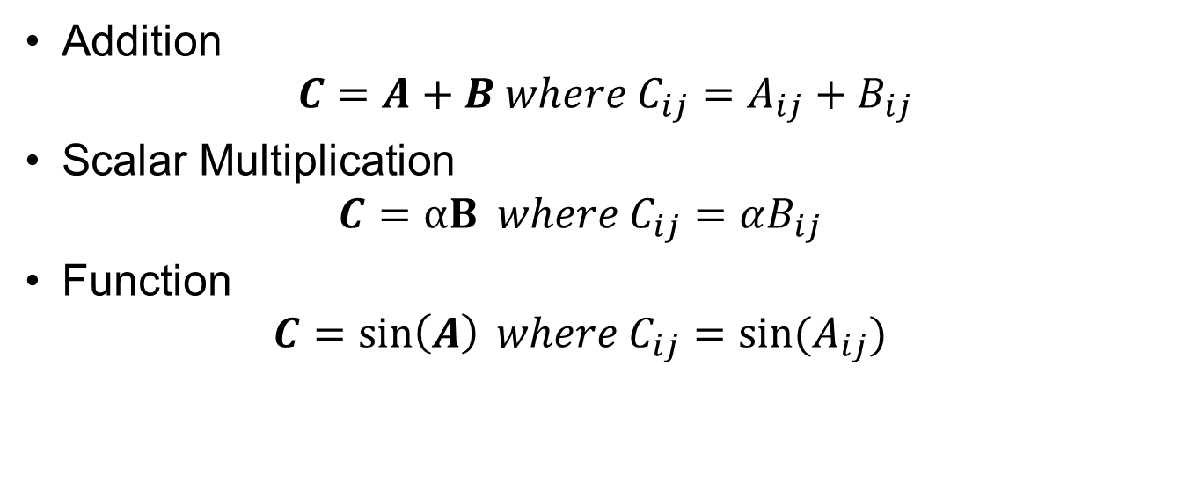
Matrix Operations
Addition
$$C=A+B where C_{ij}=A_{ij}+B_{ij}$$
Scalar Multiplication
$$C=αB where C_{ij}=αB_{ij}$$
Function
$$C=\sin\left(A\right) where C_{ij}=sin⁡(A_{ij})$$

Slide 30

Matrix Norm
${\left\|A\right\|}_{Frobenious}= {\left[\sum_{ij}{A_{ij}^{2}}\right]}^{\frac{1}{2}}$

Slide 31
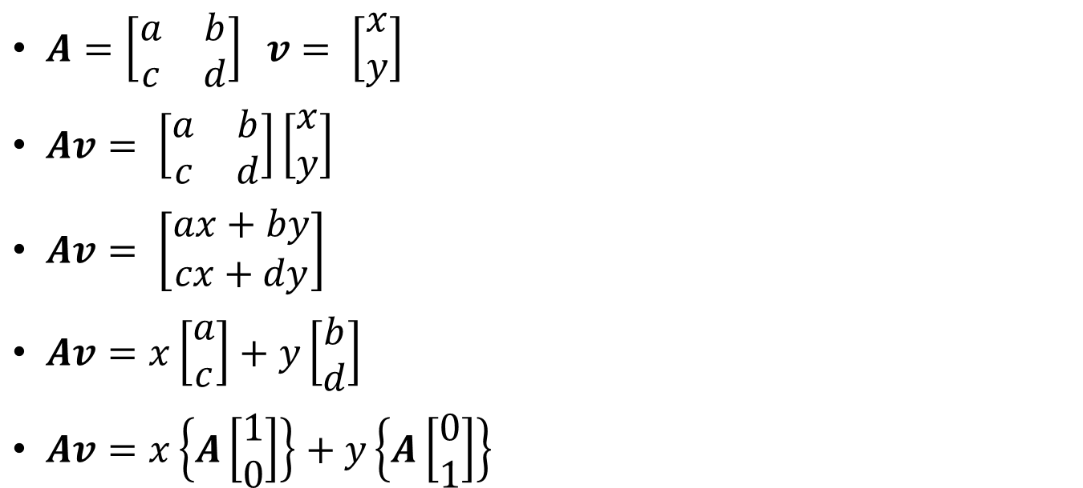
Linear Transformation
$A=\left[\begin{matrix}a & b \\ c & d\end{matrix}\right] v= \left[\begin{matrix}x \\ y\end{matrix}\right]$
$Av= \left[\begin{matrix}a & b \\ c & d\end{matrix}\right]\left[\begin{matrix}x \\ y\end{matrix}\right]$
$Av= \left[\begin{matrix}ax+by \\ cx+dy\end{matrix}\right]$
$Av=x\left[\begin{matrix}a \\ c\end{matrix}\right]+y\left[\begin{matrix}b \\ d\end{matrix}\right]$
$Av=x\left\{A\left[\begin{matrix}1 \\ 0\end{matrix}\right]\right\}+y\left\{A\left[\begin{matrix}0 \\ 1\end{matrix}\right]\right\}$

Slide 32
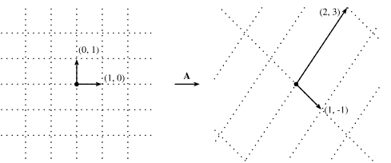

Geometric View – Linear Transformation
$A= \left[\begin{matrix}1 & 2 \\ −1 & 3\end{matrix}\right]$
$v= \left[\begin{matrix}2 \\ −1\end{matrix}\right]$
Figure taken from d2l.ai

Slide 33
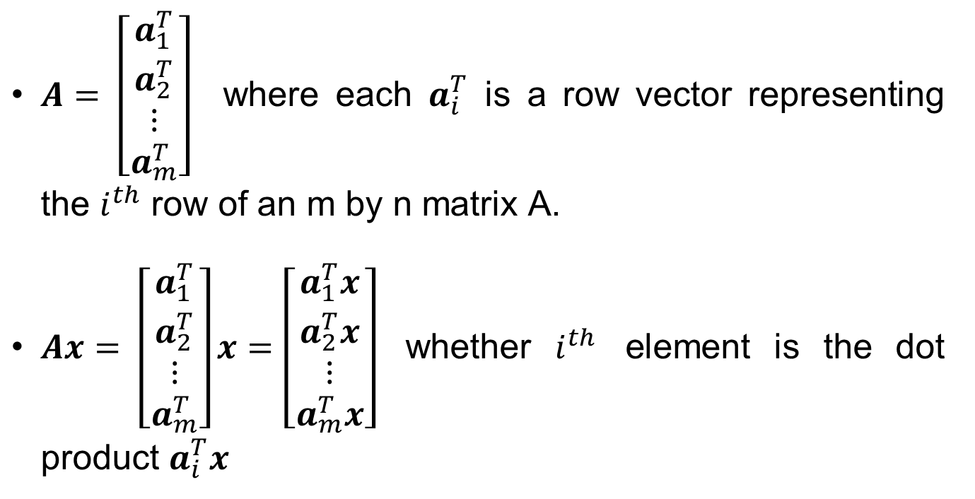
Matrix – Vector Product
$A= \left[\begin{aligned}a_{1}^{T} \\ a_{2}^{T} \\ ⋮ \\ a_{m}^{T}\end{aligned}\right]$ where each $a_{i}^{T}$ is a row vector representing the $i^{th}$ row of an m by n matrix A.
$Ax= \left[\begin{aligned}a_{1}^{T} \\ a_{2}^{T} \\ ⋮ \\ a_{m}^{T}\end{aligned}\right]x=\left[\begin{aligned}a_{1}^{T}x \\ a_{2}^{T}x \\ ⋮ \\ a_{m}^{T}x\end{aligned}\right]$ whether $i^{th}$ element is the dot product $a_{i}^{T}x$

Slide 34
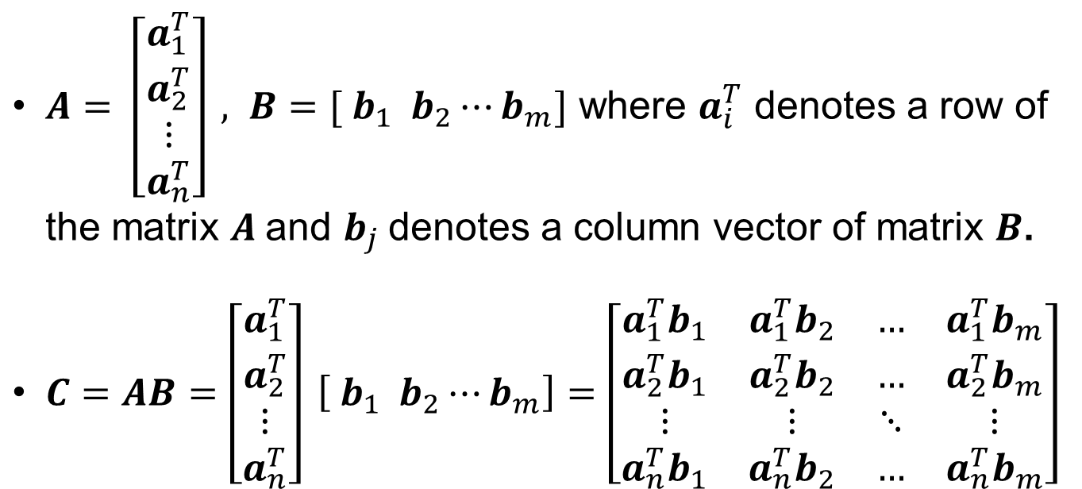
Matrix - Matrix Multiplication
$A= \left[\begin{matrix}a_{1}^{T} \\ a_{2}^{T} \\ \begin{aligned}⋮ \\ a_{n}^{T}\end{aligned}\end{matrix}\right] , B=[ b_{1} b_{2}⋯b_{m}]$ where $a_{i}^{T}$ denotes a row of the matrix $A$and $b_{j}$denotes a column vector of matrix $B$.
$C=AB=\left[\begin{matrix}a_{1}^{T} \\ a_{2}^{T} \\ \begin{aligned}⋮ \\ a_{n}^{T}\end{aligned}\end{matrix}\right] \left[ b_{1} b_{2}⋯b_{m}\right]=\left[\begin{matrix}a_{1}^{T}b_{1} & a_{1}^{T}b_{2} & … & a_{1}^{T}b_{m} \\ a_{2}^{T}b_{1} & a_{2}^{T}b_{2} & … & a_{2}^{T}b_{m} \\ ⋮ & ⋮ & ⋱ & ⋮ \\ a_{n}^{T}b_{1} & a_{n}^{T}b_{2} & … & a_{n}^{T}b_{m}\end{matrix}\right]$

Slide 35

Identity Matrix
$I= \left[\begin{matrix}1 & 0 & … & 0 \\ 0 & 1 & … & 0 \\ ⋮ & ⋮ & ⋱ & ⋮ \\ 0 & 0 & … & 1\end{matrix}\right]$
$For all A, AI=IA=A$

Slide 36

Diagonal Matrix
$D= \left[\begin{matrix}d_{1} & 0 & … & 0 \\ 0 & d_{2} & … & 0 \\ ⋮ & ⋮ & ⋱ & ⋮ \\ 0 & 0 & … & d_{n}\end{matrix}\right]$
$For all x, Dx= \left[\begin{matrix}d_{1}x_{1} \\ \begin{aligned}d_{2}x_{2} \\ ⋮\end{aligned} \\ d_{n}x_{n}\end{matrix}\right]$

Slide 37
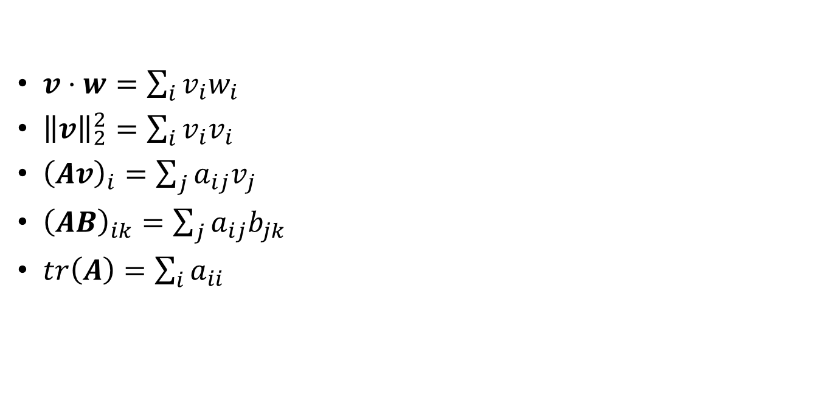
Compressed Notation
$v⋅w=\sum_{i}{v_{i}w_{i}}$
${\left\|v\right\|}_{2}^{2}=\sum_{i}{v_{i}v_{i}}$
${\left(Av\right)}_{i}=\sum_{j}{a_{ij}v_{j}}$
${\left(AB\right)}_{ik}=\sum_{j}{a_{ij}b_{jk}}$
$tr\left(A\right)=\sum_{i}{a_{ii}}$

Slide 38
References
https://d2l.ai/chapter_preliminaries/linear-algebra.html#
https://d2l.ai/chapter_appendix-mathematics-for-deep-learning/geometry-linear-algebraic-ops.html
https://www.deeplearning.ai/courses/mathematics-for-machine-learning-and-data-science-specialization/

